Slide 1


PHP Development Course
MEC Academy

Slide 2
Agenda
Introduction in list
one-dimensional array
Foreach loop
multi-dimensional array
associative array
Build in function of arrays and string
Dependencies
&
Issues / Risks
Schedule (High Level)
Completed Activities
Timeline
Action
Items
Change Requests

Slide 3

introduction
Arrays are an essential part of any programming language, and PHP is no exception. In PHP, arrays are a way to store multiple values in a single variable. They can be used to represent lists, tables, or even sets of data.
we need to know every thing about arrays. how arrays represent in memory and how i access these arrays, we go in deep, my bros
array

Slide 4
Types Of Arrays
one-dimensional array
multi-dimensional
associative array

Slide 5
Ready?

Slide 6


one-dimensional array
Declaring Arrays in PHP In PHP, you can declare an array using the array() function. The general syntax for declaring an array is:
Example:

Slide 7
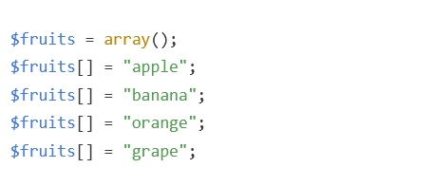
one-dimensional array
You can also create an empty array and add items to it later:

Slide 8
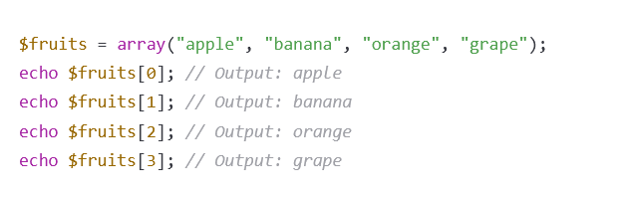
Accessing Array
Accessing Array Elements PHP arrays are zero-indexed, which means the first element has an index of 0, the second element has an index of 1, and so on. To access an element of an array, you use square brackets [] with the index of the element you want to access:

Slide 9
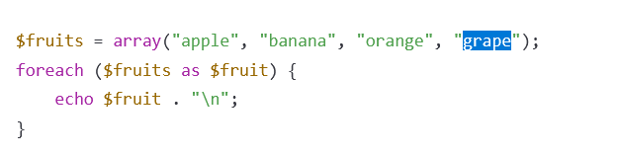
Accessing Array
You can also use loops to iterate over the elements of an array:

Slide 10

one-dimensional array in memory
A one-dimensional array is represented in memory as a contiguous block of elements, where each element occupies a fixed amount of memory. The elements are stored sequentially, and the position of an element can be computed using its index.
This would be represented in memory as a single contiguous block of memory containing 5 integer values (in this case, 1, 2, 3, 4, and 5).

Slide 11
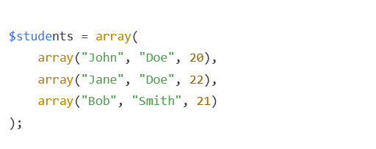
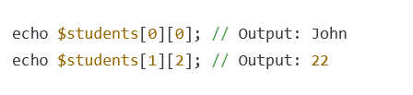
Multi-Dimensional Arrays
To access an element of a multi-dimensional array, you use multiple indexes:
Hint: Use loops to access two dimensional array

Slide 12
What is Linked list?

Slide 13
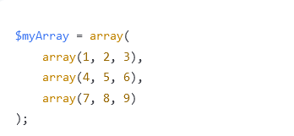
Multi-Dimensional arrays in memory
a multi-dimensional array in PHP is represented in memory as an array of arrays. That is, each element of the outer array points to another array, which itself can contain more arrays or individual values. In this way, a multi-dimensional array can be thought of as a series of nested arrays.
In memory, this would be represented as an array of pointers to three different arrays, each of which contains three integer values.
The first pointer would point to an array containing the integers 1, 2, and 3. The second pointer would point to an array containing the integers 4, 5, and 6, and so on.

Slide 14
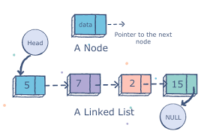
Multi-Dimensional arrays in memory

Slide 15
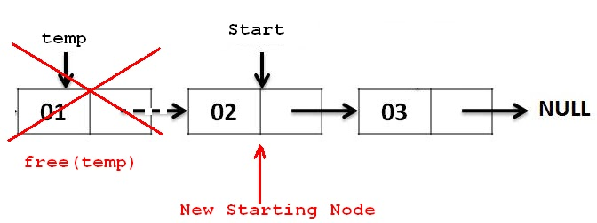
Multi-Dimensional arrays in memory

Slide 16
Multi-Dimensional arrays in memory

Slide 17
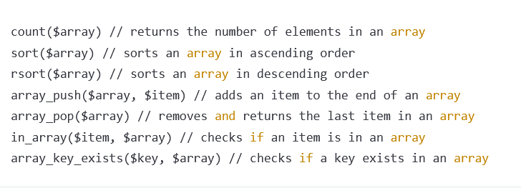
Array Functions in PHP

Slide 18
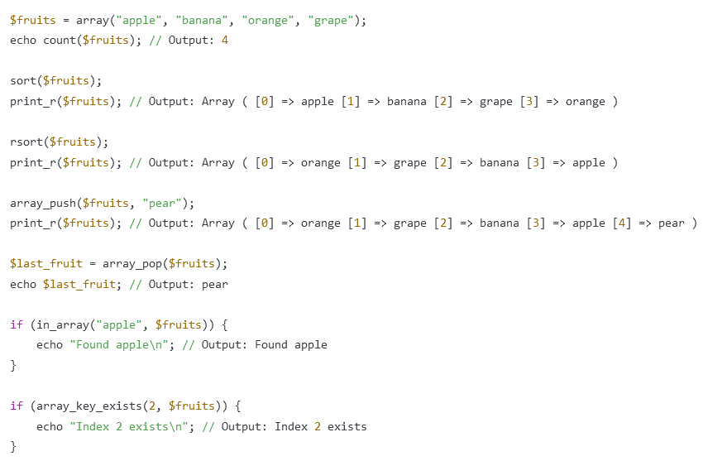
Array Functions in PHP

Slide 19
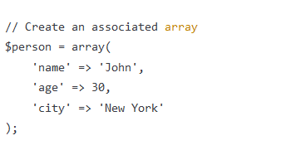
Associated array
In PHP, an associated array is a type of array where keys are assigned to each element of the array. This means that instead of accessing elements using numeric indices (such as $myArray[0]), you can use string keys (such as $myArray['name']).

Slide 20
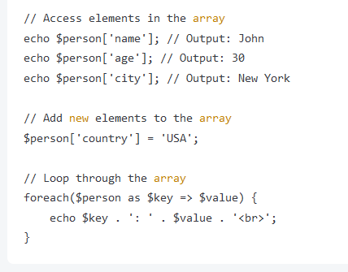
Associated array

Slide 21
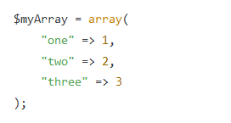
Associated array in memory
An associative array, is represented in memory as a hash table. Each element in the array is represented by both a key and a value, and the key is used to look up the associated value.
In memory, this would be represented as a hash table with keys "one", "two", and "three" mapping to their respective values (1, 2, and 3).

Slide 22
What is hash table?

Slide 23
String
follow me to the VS code!

Slide 24
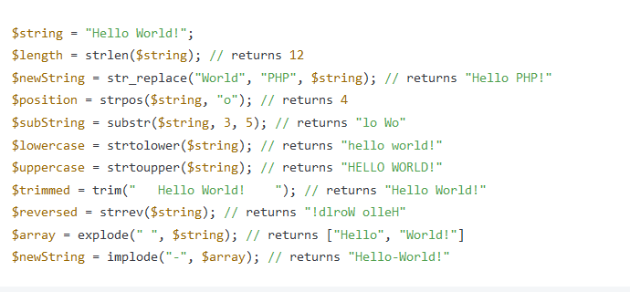
String functions

Slide 25
Super global !

Slide 26


